Slide 1


Balani/iGroup Infotech India Pvt. Ltd.
Welcome’s you to
21st National Convention on Knowledge, Library and Information Networking NACLIN – 2018
Vizag - Andhra Pradesh

Slide 2
Brief Profile
Incorporated in 1987
Group of 6 companies:
  Aditya Books Pvt. Ltd.
  A2Z Teaching & Learning Solutions Pvt. Ltd.
  Balani Infotech Pvt. Ltd.
  iGroup Infotech India Pvt. Ltd.
  Lawman India Pvt. Ltd.
  Global Music University
Total staff force of over 85

Slide 3


Our Presence
New Delhi
Noida
Ahmedabad
Kolkata
Mumbai
Pune
Head Office
Associate Office
Branch Office
Bangalore

Slide 4









Government Organizations
CeRA

Slide 5













Some of the Societies Exclusively Represented By Balani Infotech & iGroup
(print)

Slide 6










Some of the Publishers Exclusively Represented By Balani Infotech & iGroup

Slide 7








Some of the Publishers & Societies Represented By Balani Infotech & iGroup

Slide 8







Some of the Publishers & Societies Represented By Balani Infotech & iGroup

Slide 9





Some more Products exclusive with
Balani Infotech

Slide 10


World eBook Library
Read eBooks & Academic Articles Anywhere

Slide 11
About World eBook Library
World’s largest eBook Collection, founded in 1996
Over 33,00,000 eBooks, eArticles & eJournals
50+ Academic University Presses & Libraries
First and only one to offer Digitally Re-Mastered Editions
One Millennium Collection of primary source material
Unlimited downloading, without restriction
Available 24 hrs a day, 7 days a week

Slide 12
What is a Digitally Re-mastered eBook?
The images of these books are increased in original scan
Pages are digitally whitened to eliminate eye-straining yellowish color
Optical Character Recognition is added to enable Text-Search
Removal of blank pages
Re-sizing of page

Slide 13





Topics
Agriculture
Anthropology
Astronomy
Bibliography
Biology
Chemistry
Commerce
Economy
Education
Finance
Fine arts
Geography
Government
History
Language
Literature
Management
Math
Law
Medicine
Military science
Music
Naval science
Philosophy
Physics
Political science
Psychology
Recreation
Reference collection
Religion
Sociology
Statistics
Technology

Slide 14
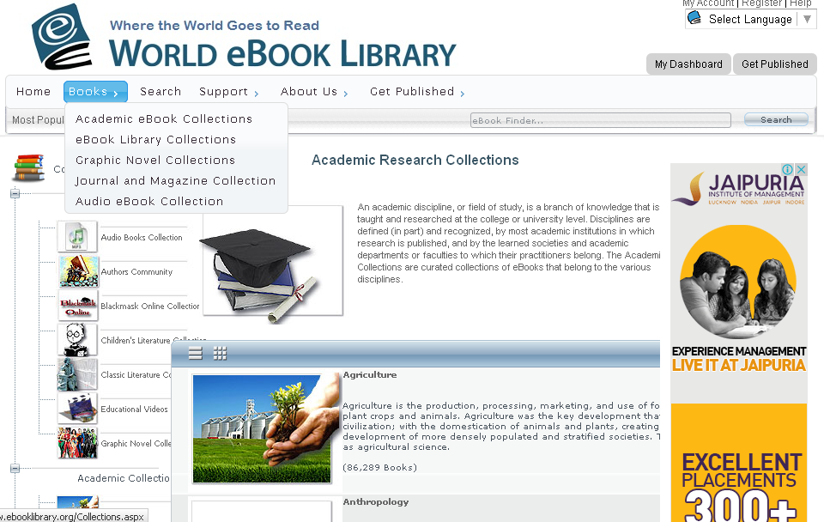
Types of Collections

Slide 15


IGI Global
International Publisher of Progressive Information Science and Technology Research

Slide 16
IGI Global Background
Founded in 1988
Headquartered in Hershey, Pennsylvania (USA)
International publisher of reference books, journals, and videos
Research focuses on the latest information science and technology advancements in academic subject areas
E-Resources innovator

Slide 17

IGI Global Research Growth
Promote Information Science and Technology Research
Partners with IRMA
169 Journals
Over 3,900 Books
E-Resources Leader
Conferences
Academic Papers
Expert Contributors
Peer-Reviewed
Comprehensive
Prestigious Indices
Cutting-Edge Research
Highly Cited
200 Subject Areas
Top-Rated Platform
Over 3,000 Customers in 160 Countries
Academic Video Lectures

Slide 18
11 Diverse Subject Areas
Focusing on Information Science and Technology Research
Business and Management Information Science and Technology
Computer Science and Information Technology
Educational Science and Technology
Engineering Science and Technology
Environmental Science and Technology
Government Science and Technology
Library Information Science and Technology
Media and Communication Science and Technology
Medical, Healthcare, and Life Science and Technology
Security and Forensic Science and Technology
Social Sciences and Online Behavior

Slide 19








Interdisciplinary Content
IGI Global’s content features crucial trending topics of research across disciplines. From journals to books and videos, new content is available in databases weekly.
Journals
Videos
Reference Books
Handbooks of Research
Multi-Volume Books
Research Essentials
Case Books
Research Essentials
Critical Explorations

Slide 20





Peer-Reviewed and Indexed
All journals and books highly recognized and acquired through several indices
ACM Digital Library
Bacon’s Media Directory
Cabell’s Directories
INSPEC
Index of IS Journals
DBLP
PsycINFO
Compendex
Scopus
Thomson Reuters

Slide 21







Top-Rated Platform for Researchers
Full-text in XML and PDF
No DRM: Copy, Paste, and
Print Directly from the Platform
Unlimited Simultaneous Users
Advanced Search Engine
Popular Citation Tools
No Embargo of Content

Slide 22
Thank you
Arjun - BIPL

